Slide 1
Standards
Australia and New Zealand

Slide 2
Standards Australia Working Groups
EL-010 Overhead Lines
EL-024 Protection Against Lightning
EL-043 High Voltage Insulators
EL-052 Electrical Energy Networks, Construction and Operation

Slide 3
EL-052 Electrical Energy Networks, Construction and Operation
  Sponsors
    Electric Energy Society of Australia
    NSW Department of Primary Industries and Regional Development
    Energy Networks Australia
    NEXTgen
    Electrical Regulatory Authorities Council, Australia
    Communications, Electrical and Plumbing Union - Electrical Division
    National Electrical and Communications Association
    Electrical Regulatory Authorities Council, Australia
    Engineers Australia
    Electricity Engineers Association of New Zealand – Carl Rathbone
    Concrete NZ – Ross McLennan
  This group has final voting rights to approve a new or revised standard
  New Zealand must have a minimum of two non profit groups to vote

Slide 4
EL-052 Sub Committees
EL-052-00-01 Revision of AS 5804 Parts 1 to 4
EL-052-01 High-voltage Live Working
EL-052-02 Low-voltage Polarity Testing
EL-052-03 Waterways Crossings
EL-052-04 Advisory Panel for IEC TC 78
EL-052-05 Design of Overhead Electrical Lines
EL-052-05-01 Structural and Mechanical
EL-052-05-02 Electrical
EL-052-05-03 Conductors and Earth Wires
EL-052-05-04 Steering committee
EL-052-05-05 Handbook Working Group
EL-052-06 IEC TC 11 Liaison
EL-052-08 HB331 Revision Working Group
EL-052-09-01 Peer Review Group

Slide 5
AS/NZS7000:2016 Review
EL-052-05 Design of Overhead lines
Made up of industry experts from Aust and NZ
New Zealand Members
  Carl Rathbone - OLENZ Ltd
  Mitch Graham – Unison Ltd
  Ross McLennan - Busck Prestressed Concrete Ltd
80% Draft due April 2027
Completion date April 2028

Slide 6
Tasks
Review approx. 150 revisions, broken into following groups;
Snow and Ice
Composite Poles, Concrete Poles and Steel Poles
Wind Load
Timber Pole Strengths
Composite Insulators
Loads, structure, foundations

Slide 7
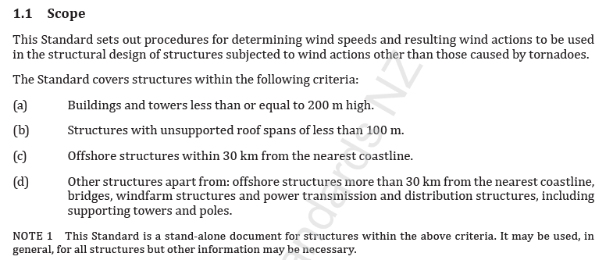

Wind Actions
AS/NZS1170.2 or AS/NZS7000?
AS/NZS1170.2:2021 Scope 1.1

Slide 8
AS/NZS7000 Appendix B
AS/NZS 1170.2 provides regional wind speeds for various return periods.
The design site wind speed shall be taken as—
Vsit,β = VR Md Mz,cat Ms Mt where
Mz,cat = gust wind speed multiplier for terrain category at height z.
See AS/NZS 1170.2, for all regions use Table 4.1(A)
Md wind direction multiplier. See AS/NZS 1170.2
Ms = shielding multiplier. See AS/NZS 1170.2
Mt = topographic multiplier for gust wind speed. See AS/NZS 1170.2
VR = basic regional wind velocity for the region corresponding to the selected
return period wind. See AS/NZS 1170.2
Designers should be aware that changing land usage may alter the terrain category.
z for the conductors shall be taken as the average conductor height or the average
attachment height.
z for structures under 50 m in height may be taken at the 2/3 structure height or at the
centre of each panel in lattice towers.
Md < 1.0 may be applied when determining design loads for sections of lines.
Ms is normally taken as 1.0.
Note, the climate change multiplier, Mc, applied in AS/NZS 1170.2:2021 is not in AS/NZS 7000:2016
Mzcat being reviewed for overhead lines

